Slide 1


LOW DENSITY PARITY CHECK ENCODING AND DECODING
DHAYANITHI M, ECE
RITHICK I , ECE
[22EC2016]

Slide 2
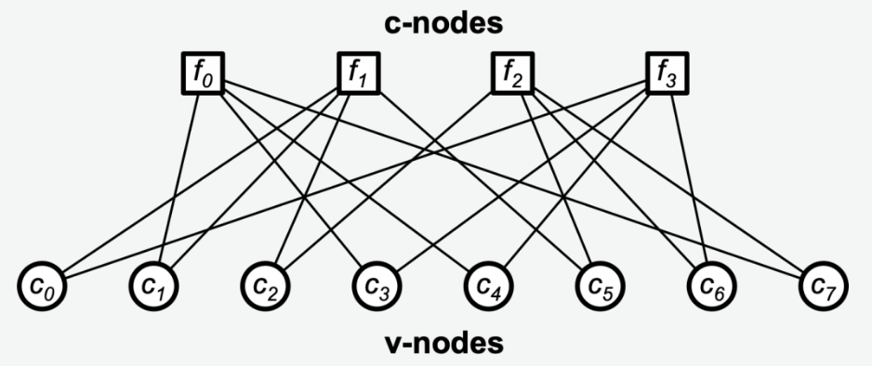
OUTLINE
Introduction
Problem statement
Overview of LDPC codes
Methodology
Results and Discussions
Graphical Results
Conclusions
References
Acknowledgements

Slide 3
Introduction
In a typical digital communication system, several steps are involved in processing the information both at the transmitting end and at the receiving end. Preprocessing and postprocessing of information is essential to ensure the utmost reliability and integrity of the final data to be utilized.
It mainly focuses on the channel coding technique and its importance for reliable communication of data.
The key advantages of Low Density Parity Check (LDPC) codes over other error correction codes, particularly for next-generation mobile and wireless communications are Higher Error-Correction Capability, Scalability and Flexibility, Reduced Power Consumption.

Slide 4
PROBLEM STATEMENT
"Efficient and Reliable Data Transmission over Noisy Communication Channels using LDPC Coding“
In digital communication, achieving reliable data transmission over noisy channels, such as in wireless or satellite communications, is a critical challenge. High levels of noise, interference, and fading can lead to frequent errors, significantly degrading the quality of data received.
Traditional error-correction techniques, such as Hamming codes or convolutional codes, are often unable to correct errors with high efficiency in these high-noise environments, especially at higher data rates. As a result, there is a need for an error-correction technique that can handle high noise levels while maintaining efficient data throughput.

Slide 5
OVERVIEW OF LDPC CODES
1.LDPC decoding involves careful design of the sparse parity-check matrix and selection of the appropriate decoding algorithm. An LDPC matrix can be constructed using random, structured or unstructured techniques.
2.LDPC codes generated from each of these techniques have significant impact on performance and implementation complexity.
3. An LDPC decoding algorithm also plays a vital role in determining error correction and decoding performance. The overall performance of an LDPC decoder is measured by various parameters in terms of bit errors, throughput, and hardware resources.

Slide 6
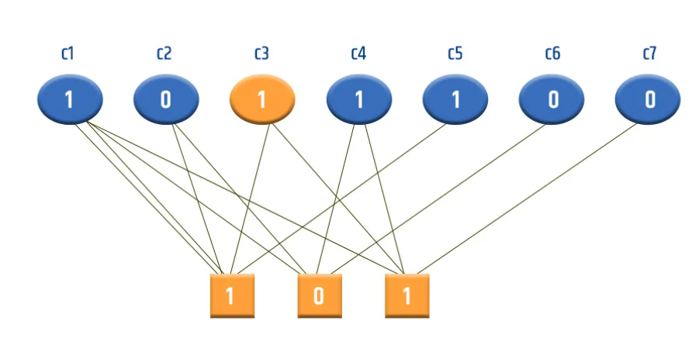
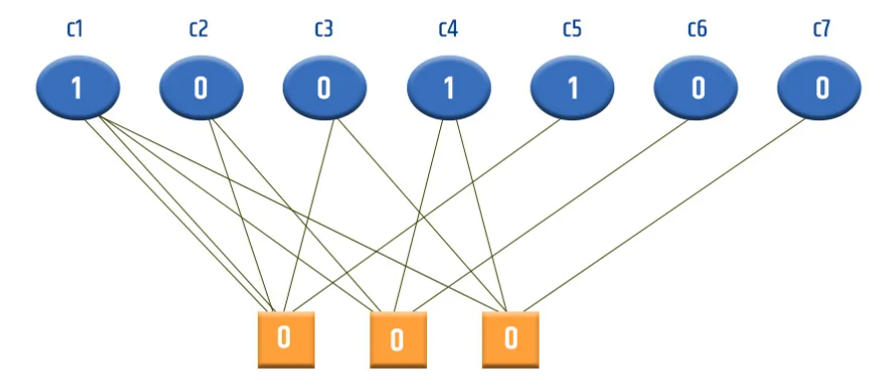
METHODOLOGY
Define the LDPC Parity-Check Matrix.
Encode the Message
Transmit through a Noisy Channel
Decode with Iterative Algorithms
Evaluate Error Detection and Correction

Slide 7
BLOCK DIAGRAM
User Interface
Encoding Process
Noise Simulation
Decoding Process
Visualization
Output Display

Slide 8
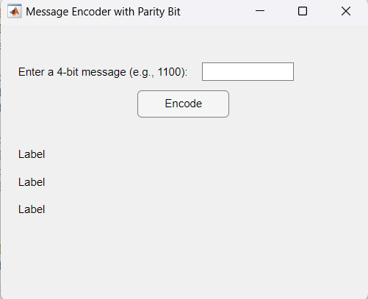
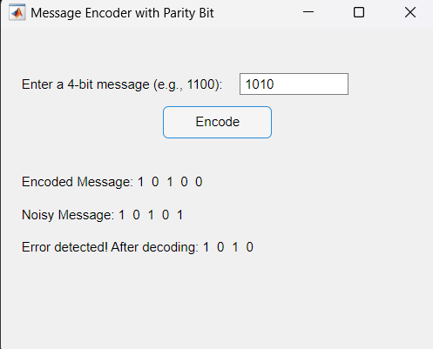
RESULTS AND DISCUSSIONS

Slide 9
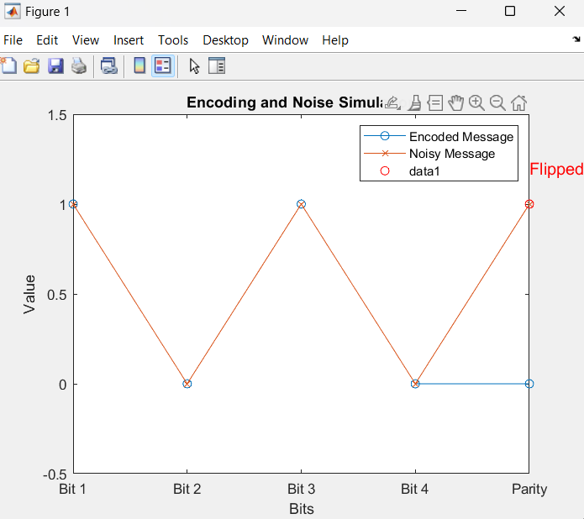
GRAPHICAL RESULT

Slide 10
CONCLUSIONS
In conclusion, Low-Density Parity-Check (LDPC) encoding and decoding is a powerful technique for ensuring accurate data transmission, even in noisy conditions.
By adding structured error-correction bits, LDPC codes allow receivers to detect and correct errors using iterative decoding methods.
This makes LDPC codes especially valuable in high-speed communication systems, like 5G and data storage, where data integrity is crucial. Overall, LDPC codes provide a highly effective solution for reliable communication.

Slide 11
REFERENCES
https://www.logic-fruit.com/blog/wireless-communication/ldpc-fec-codec/?srsltid=AfmBOopm4iY44wWMEgakQIwIYrGxHZDHIvOidQn5joixfj4okeOzXz0X

Slide 12
ACKNOWLEDGEMENTS
We acknowledge our gratitude and thank to our teacher, friends and my family members for their constant encouragement.

Slide 13
THANK YOU

